Slide 1
PREDICTING MOVIE SUCCESS
Tasllim,Yusuf, Shezan

Slide 2
PROBLEM STATEMENT
01
DATASET
02
OUTLINE
04
FEATURE SELECTION & DIMENSIONALITY REDUCTION
DATA PREPROCESSINIG
03
05
MODELS
06
RESULTS & DISCUSSION

Slide 3
01
PROBLEM STATEMENT

Slide 4
What exactly determines the success of a movie and makes it a box office winner?

Slide 5
02
DATASET

Slide 6



DATASET DETAILS
Metadata for 45,000 movies
Kaggle
Several features that weren’t needed

Slide 7
03
DATA PREPROCESSINIG

Slide 8
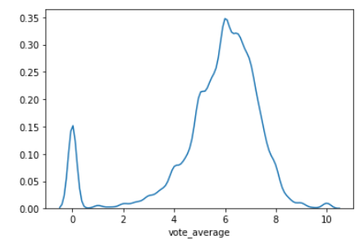
DATA PREPROCESSING - 1
1) Drop unwanted columns
BUDGET
GENRES
POPULARITY
RUNTIME
VOTE_AVERAGE
in US dollars
multiple genres per movie if applicable
quantified popularity measure
length of movie in minutes
the average of all the votes from users per movie – from 0 to 10
2) Convert to Integer (Budget, Popularity, Runtime, Vote
Average)
3) Check distribution of data
4) Remove 0 values, null,
and duplicates

Slide 9
DATA PREPROCESSING- 2
1) Process JSON list of Genres
2) Convert the vote average to class labels:
Good (7.5+) | Average (5 to 7.5) | Bad (0 to 5).
3) Initial number of samples per category : Average 5204, Bad 884, Good 479
4) Over sample Bad and Good, Under sample the Average - 2000 data points each
5) Use Min-Max scaling for numerical columns
6) Apply one hot-encoding for the Genre feature

Slide 10
04
FEATURE SELECTION & DIMENSIONALITY REDUCTION

Slide 11
FEATURE SELECTION
SelectKbest
SelectPercentile
- Selects k highest scoring features
- K = 5
- Scoring Function: Chi-squared test
- Selects features with percentile of the
highest score
- Percentile = 50%
- Scoring Function: f_classif

Slide 12
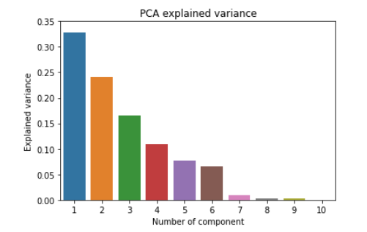
DIMENSIONALITY REDUCTION
Principal Component Analysis (PCA)
- Selects specified number of components
- Chose first 5 components
- First 5 components – 92.3%
- 6th component – 6.5%

Slide 13
DATA POSTPROCESSING
INPUT DATA
01
02
03
04
Raw Data
SelectKbest
SelectPercentile
PCA

Slide 14
05
MODELS

Slide 15
MODELS – HYPERPARAMETER TUNING
Grid search was used to find the best hyper-parameters for each model
1) Decision Tree Classifier
The parameters tuned with their respective range:
-Minimum samples required to split a node – range from 5 to 80 with increments of 5
-Maximum leaf nodes in the model – range from 5 to 80 with increments of 5
2) Naïve Bayes Classifier
Var_smoothing (portion of the largest variance added for calculation stability)
-Range from 1e-6 to 1e-15

Slide 16
MODELS – HYPERPARAMETER TUNING
3) KNN Classifier
-Weight function used in prediction – either ‘uniform’ or ‘distance’
-Number of neighbors to use for classification - range from 5 to 80 with increments of 5
4) SVM Non-Linear Classifier
-Kernel – either 'rbf' and 'sigmoid'
-C – a selection from the list: 0.1,1,10,100,1000
-Gamma – a selection from the list: 1e-4,1e-3,1e-2,0.1,1,5,10
-coef0 ( Independent term in kernel function) – range from -200 to 200, increments of 50.
5) SVM Linear-kernel Classifier
-C – a selection from the list: 0.1,1,10,100,1000

Slide 17
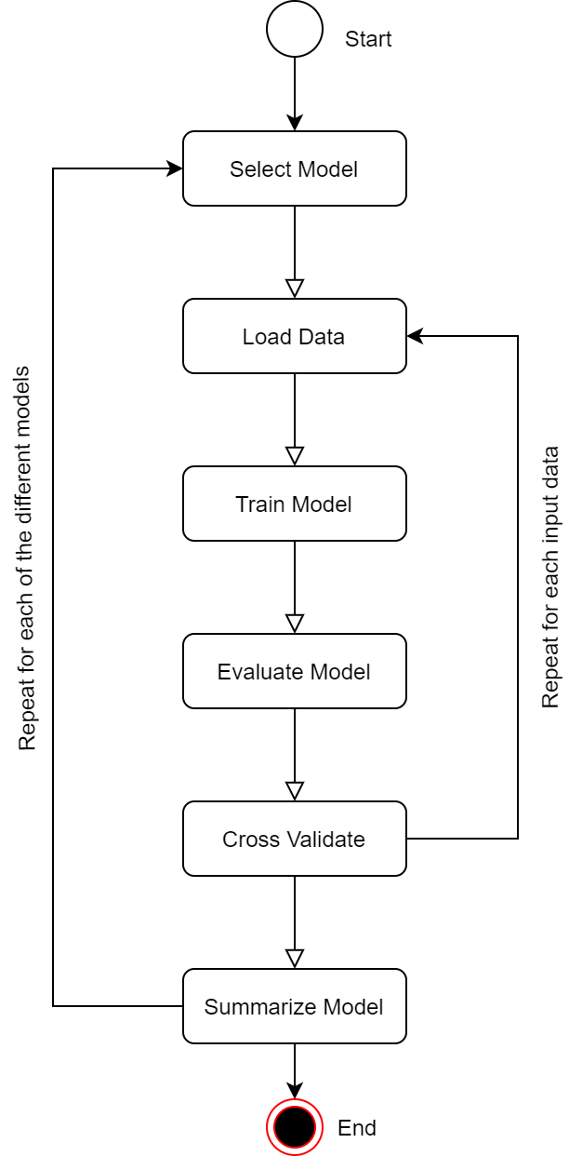
WORKFLOW DIAGRAM
5 Models
1) Decision Tree
2) Naive Bayes
3) KNN
4) SVM non-linear
5) SVM linear
4 Input Data
1) No feature selection (default)
2) selectKBest
3) selectPercentile
4) PCA

Slide 18
06
RESULTS & DISCUSSION

Slide 19
EVALUATION CRITERIA
1) Macro F1-Score from GridSearch applied on each model
2) Training Score of best classifier
3) Testing score of best classifier
4) Classification report with precision, recall and f1-score for each rating class
5) Confusion Matrix
6) F1-scores from 5-fold cross-validation with best classifier

Slide 20
RESULTS & DISCUSSION
 | MODEL | MACRO f1 SCORE
1 | Decision Tree Classifier | 0.656956
2 | Naive Bayes Classifier | 0.547154
3 | KNN Classifier | 0.783097
4 | SVM Non-Linear Kernel | 0.651570
5 | SVM Linear Kernel | 0.579962
6 | Decision Tree Classifier | 0.656956

Slide 21
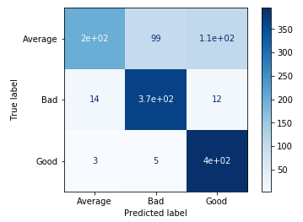
RESULTS & DISCUSSION
KNN with 20 nearest neighbors and distance similarity measure (default data)
Class Label | Precision | Recall | F1-Score
Average | 0.92 | 0.49 | 0.64
Bad | 0.78 | 0.93 | 0.85
Good | 0.77 | 0.98 | 0.86
Cross Validation Scores: 0.81469157, 0.7833312, 0.80917577, 0.77961212, 0.79184328

Slide 22
THANK YOU
Please let us know if you have any questions!

